Slide 1
Unit Fractions Math For Teaching
Notes:
Welcome to today’s session on Unit Fractions. I am ___________.

Slide 2
Learning Focus
Participants will:
understand what a unit fraction is and how this changes the way we think about fractions
examine how unit fractions can support learning across number systems and algebraic contexts
develop deeper understanding of fraction as a number by engaging in the actions of partitioning, iterating and disembedding
Notes:
Our session today is based upon many years of research, including the recent research within Ontario lead by Dr. Cathy Bruce in partnership with the Curriculum and Assessment Policy Branch of the Ministry of Education. The research has highlighted some critical fractions learning which we will explore further today. In particular, you will:
(Bullet 1): we will revisit the constructs from the first session
(Bullet 2): research shows that unit thinking enhances understanding across many mathematical concepts and fractions in particular
(Bullet 3): instructional strategies will be highlighted in this presentation

Slide 3
Agenda
 | Intended Audience
Review of Five Constructs: Card Sort | Educator
Research Overview: Why study fractions?
Unit Fraction Counting Game | Student
Building Understanding of Unit Fractions
Partitioning, Iterating and Disembedding
Partitioning, Iterating and Disembedding Tasks | Student
Unit Fractions Across K-12 Curriculum
I Have…Who Has… Task | Student
Notes:
This is what we will be doing in this session. Notice that we have identified the intended audience for the tasks. The tasks designated as Educator are not intended to be used with students.

Slide 4
Session Norms
Be engaged in the tasks and discussions as this enriches everyone’s experience.
Be a learner – it is fun!
Actively seek connections between the research and your classroom experience.
By better understanding student thinking we better understand the impact we can have on their learning.
Notes:
These are the norms for today’s session.

Slide 5
Multiple Fractions Meanings (Constructs)
Part-whole relationship
Part-part relationship (ratio)
Linear measure (distance from 0)
Fraction as operator (multiplicative action on quantity)
Fraction as quotient (division relationship)
A fraction is one quantity or amount
Notes:
<<Note to Presenter: text enclosed by << >> are notes for the presenter and not part of the script>>
<<Distribute one copy per person: one pager Math Teaching for Learning, Ways we Use Fractions>>
In the previous session we learned about the five constructs. When instructing fractions most of our focus and certainly our starting point has over the years been with the part-whole relationship.
However, it is clear there are multiple constructs of fractions <<click through the rest of the fractions to quotient>> and research in this area encourages working toward a deeper understanding of the multiple constructs to support student learning beyond fractions.
As well, when teachers hold a deeper understanding of these constructs they are able and inclined to naturally enhance their instruction. They often draw student attention to the various applications across the constructs. This will develop in the students a deeper understanding (e.g., ‘when instructing about the digits of the fraction…the denominator, a teacher with a deeper understanding of the various constructs may take time to bring the student’s attention to the truth that the denominator tells you the number of equal sized pieces the whole has been cut into for a part-whole fraction but not for a part-part fraction; or the teacher should explain that ‘multiplying two numbers always results in a larger number’ is true for whole numbers but not fractions).
So we agree that a deeper understanding of the multiple constructs of fractions is important to support students in learning beyond fractions, This learning includes:
writing slope expressions in grade nine and beyond, which are part-part relationships
understanding fraction as an operator (enlarging/shrinking action) (multiplying by fractions less than one shrinks the quantity; multiplying by fractions more than one enlarges the quantity). This understanding extends into functional thinking in secondary school and also connects to decimal number operations.
distinguishing between when to apply the rules for operations with part-whole fractions and the rules for part-part fractions. For example, when adding part-whole fractions as numbers, a common fractional unit or denominator is essential but when adding part-part fractions, as in ratios, the numerators are added together and the denominators are added together. Teachers do this always when marking tests…recall the example from the first session.
Let’s take some time to engage in an activity that reviews the constructs.
For more information, see the Literature Review Foundations to Teaching and Learning Fractions: Addition and Subtraction and Paying Attention to Fractions.

Slide 6
Card Sort
Match each of the representations with the
appropriate construct
b) Discuss with your table mates any cards that posed a
challenge
Notes:
<<Create the card sorting envelopes using BLM 1.>>
Each table has an envelope containing a selection of cards. As a group, you will sort the representation on each card into the different fraction constructs. Once the task has been completed, your table will compare your choices with another table and discuss any that posed a challenge.
<<BLM 2 : suggested answers for facilitator>>

Slide 7
Why Research the Teaching and Learning of Fractions?
The mathematics education literature is resounding in its findings that understanding fractions is a challenging area of mathematics for North American students to grasp (National Assessment of Educational Progress, 2005).
(Bruce & Ross, 2009)
Notes:
I would like to highlight some key research statements to provide a bit of context to our learning today. <<read quote>> Many adults express fear and anxiety when asked to engage with fractions.

Slide 8
Prior Learning which Connects to Fractions
Fractions understandings are underpinned by larger mathematics cognitive processes including:
proportional reasoning (Moss & Case, 1999)
spatial reasoning (Mamolo, Sinclair, Whitely, 2011)
Notes:
<<read slide>>
Students need to have lots of experience with developing proportional reasoning and spatial reasoning skills to build a basis for working with fractions.

Slide 9
Subsequent Learning Which Connects to Fractions
Fractions themselves underpin:
probability (Clarke & Roche, 2009)
algebraic reasoning (Brown & Quinn, 2007; Empson & Levi, 2011)
The College Mathematics Project identified fractions as an area in which students struggled in their first year college math courses.
Notes:
<<read slide>>
It may be surprising that fractions have such a strong impact on algebraic reasoning. Often educators underestimate the importance of fractions in students’ learning, in part because there may only be a few expectations within the curriculum for any specific grade. However, a strong foundational understanding of key concepts, including that of unit fractions, along with precise instruction such as use of powerful representations and precise language, is critical to subsequent success.

Slide 10
Implications Beyond Childhood
Adults continue to struggle with fractions concepts (Lipkus, Samsa, & Rimer, 2001; Reyna & Brainerd, 2007) even when fractions are important to daily work-related tasks.
(Bruce & Ross, 2009)
Notes:
In the first session participants came up with lots of examples of where fractions are used in their lives. We often use fractions without realizing the construct we have applied. When people become more aware of the fractions constructs they often notice that they encounter fractions more often than they realized.

Slide 11
Did you hear the story….
about the repairman who told the homeowner that they needed to get a one-third horsepower motor for their garage door because it would be more powerful than a one-half horsepower motor?
about the Tim Horton’s employee who, when a customer ordered a coffee with ‘half cream and quarter sugar’ filled the coffee cup half full of cream?
Notes:
<<read the two stories on the slide>> These are true stories. There are many other examples of fraction misunderstanding. For example, a woman orders a large pizza. She is asked if she wants it cut into 8 or 10 pieces. She replies “8 pieces. We couldn’t possibly eat 10 pieces of pizza.”

Slide 12
Unit Fractions Counting Game
Start in a circle
b) Someone in the circle choose a unit fraction, such as
c) The first person in the circle will say “one one-sixth“,
the second person will say “two one-sixths “, the third
person will say “ three one-sixths” etc. When a
person arrives at a whole number (e.g., six one-sixths)
they are to stand up and say the whole number equivalent.
d) Be sure to count well past one
Notes:
This game can be used for students to learn how to count fractions in various ways, developing a sense of magnitude. Counting using unit fractions allows students to understand the role of the numerator and of the denominator. Just a reminder that a unit fraction is any fraction with a 1 in the numerator, so one-half, one-one hundredth, one-thirteenth are all unit fractions. <<This game is found in Unit D of the Fractions Learning Pathway.>>
Although this language will be foreign to many of you, I would ask that you count as indicated.
Let’s do a practice run with a visual model. This can represent one whole <click>. If I say ‘1 one-sixth’ <click>, the next person would say ‘2 one-sixths’ <click>, then the third person would say ‘3 one-sixths’ <click>. I would then say ‘4 one-sixths’ <click>, the next person would say ‘5 one-sixths’ and the third person would say ‘6 one-sixths or one’ and stand up. We can keep counting to 7 one-sixths <click> etc.
Okay – in your table groups, pick a unit fraction and count. I will give you two minutes to do this.
<<after two minutes>>
Alright, I am going to ask you to do that again – you can use the same unit fraction or change it. Now count around your group but this time stop after you have gone around twice. Please persist with the counting structure even if it is uncomfortable. We will make sense of it – I promise!
I need to hear the last number that one group said <<don’t look at the group, just get them to call out their numbers>>. So, what can you tell me about that group – if they counted around twice and landed at (number).
<<For example, if a group landed at 6 one-thirds, others could state that they recognize there are 3 people in the group, since they know 6 divided by 2 is 3 (or 3+3=6 or 3x2=6). This is indicative that they are attending to the count and using their whole number reasoning to draw a conclusion.
Others could also state that they counted by one-thirds. This indicates that they are attending to the fractional unit.
Others could identify that they landed at a fraction which is equivalent to 2. Again, this could be a blend of whole number reasoning and fractional understanding; if they use benchmarks then they are demonstrating fraction number sense.>>

Slide 13
Adaptations and Connections
Select a unit fraction so that you can count around the circle once and end between 1 and 2
Select a unit fraction so that you can count around the circle twice and end between 1 and 2
Select a unit fraction so that you can count around the circle once and end at a number less than one-fourth
Notes:
Now lets consider some other prompts with this task.
First, at your table, select a unit fraction so that you can count around the table once and end at a number between 1 and 2. Note that between means not equal to 1 and not equal to 2. <<allow some time for them to discuss the unit fraction and complete the count.>>
Now that everyone has completed that, let’s hear some of the strategies that you used to determine a unit fraction that would work.
<<People may share that they counted the number of people at their table and then selected a unit fraction with a denominator one digit larger (six people so count by sevenths) or that they counted the number of people at the table and then doubled it to create a benchmark (or range) (six people at the table so six sixths would be 1 and twelve sixths would be 2 – we can count by fifths as six fifths would be more than 1 and less than 2). There may be other strategies.>>
Now you need to select a unit fraction so that you can count around the table twice and end at a number between 1 and 2. Note that between means not equal to 1 and not equal to 2.
<<Allow some time for them to select the fraction and count. Often this is completed faster.>>
Now that everyone has completed that, let’s hear some of the strategies that you used.
<<Elicit a few strategies – including using a smaller unit fraction (which is equal to half of the first unit fraction, for example) or considering the count as above.>>
Now, our last challenge, is to select a unit fraction so that you can count around the table once and end at a number less than one-fourth. <<Allow some time for this task.>>
See how separating the count (numerator) and the fractional unit (denominator) supports students in using both whole number reasoning and proportional reasoning to arrive at an answer. This supports development of fractional number sense and will provide students with strategies that will extend into subsequent learning, including algebra. Although it seems awkward to us as it is unfamiliar, for students they grasp it quickly.
<<Sometimes adults worry about confusing students with the unit counting language. If this issue is raised, write a fraction such as 2 ½ and ask people to read it aloud. They will say ‘two AND one-half’. To avoid confusion when writing a count of unit fractions, we use words for the count and symbols for the fraction unit, such as ‘two 1/3, three 1/3’.>>

Slide 14
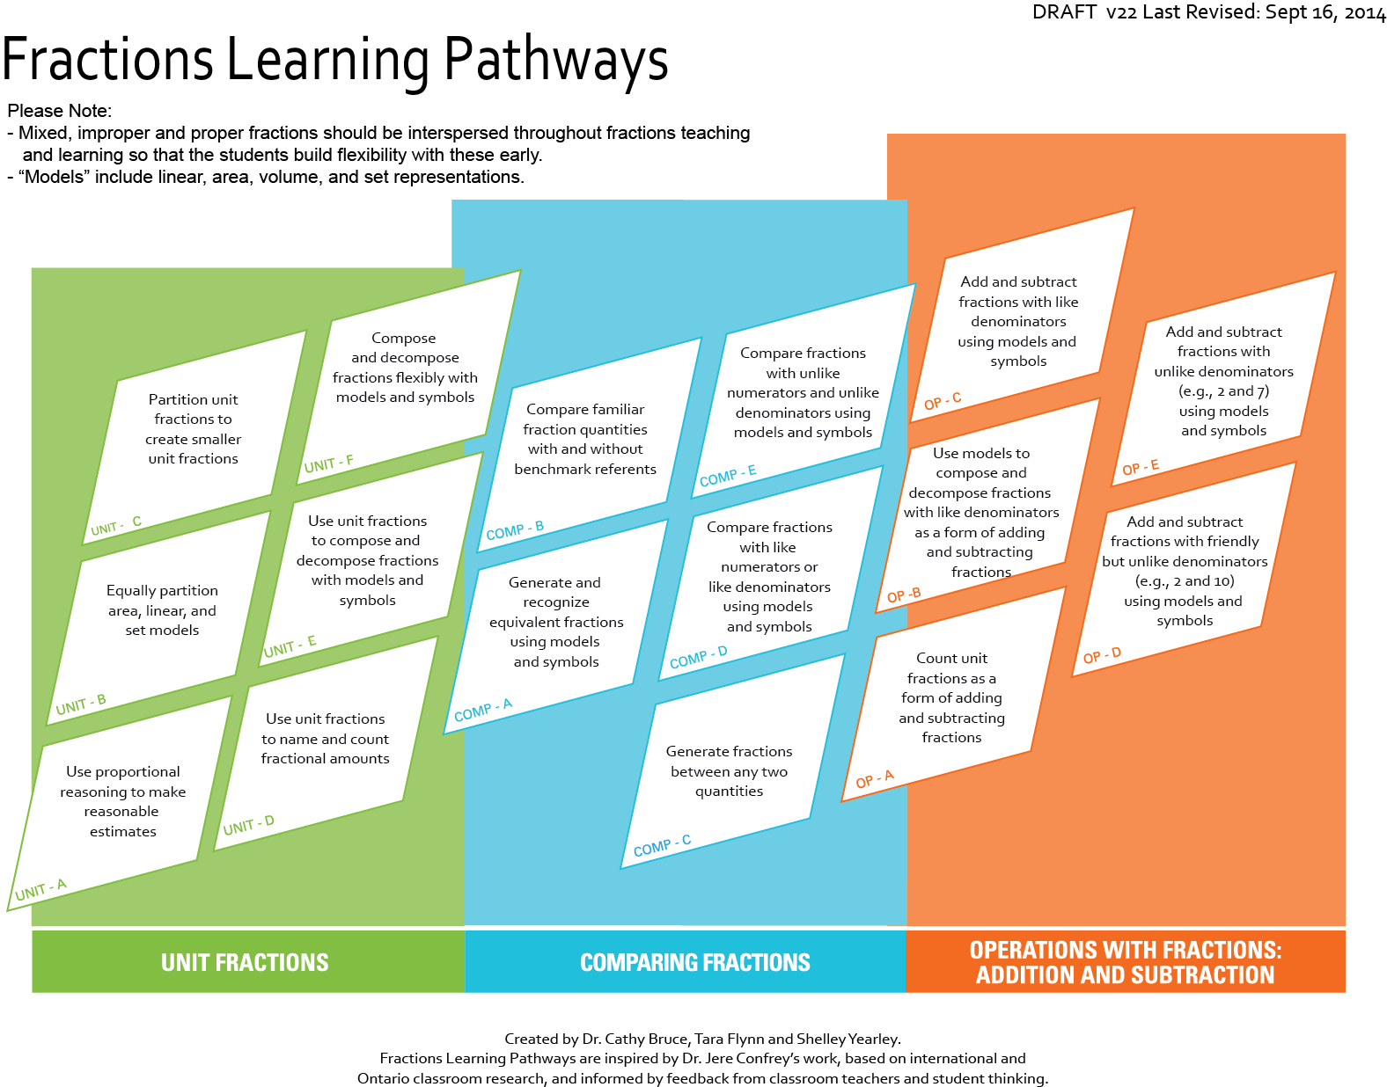
fractionslearningpathways.ca
Notes:
This is the Fractions Learning Pathways, which is an on-line, interactive resource. You can see that there are three clusters – unit fractions, comparing fractions and operations: addition and subtraction. Each cluster is comprised of cells which identify the knowledge and skills that research has demonstrated are required for successful fractions understanding. Clicking on a cell brings you to a landing page, which has a brief summary of the research on the left and links to tasks on the right. Clicking on a task allows you to access the task template (written by teachers involved in the research) which includes all task templates, an implementation video/photo (sometimes), student thinking samples and related research links. The research team is currently working on two more clusters on multiplication and division. Subscribe to an RSS feed on edugains.ca to ensure that you know when more information is added, including tasks currently in review.

Slide 15
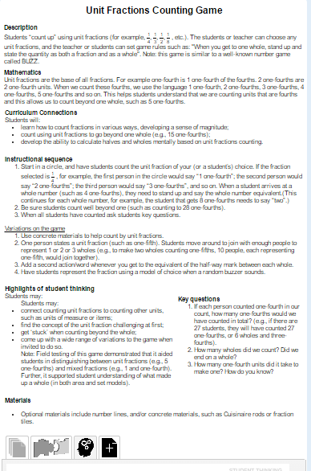
Unit C: Fractions Counting Game
Notes:
This game is available on the Fractions Learning Pathways under Unit C. The task includes precise instructions, anticipated student thinking and additional support materials.

Slide 16
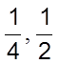
Explicit Instruction of Unit Fractions
Students should have the experience of composing and decomposing part-whole fractions using unit fractions:
e.g.,
e.g., is ‘2 one-fifth units’
Use of unit fractions allows students to make connections between the different number systems and “provides a catalyst for students’ transition from whole to rational numbers” (Charalambous et al., 2010)
Notes:
It is important to recognize what the numerator in the fraction and the denominator in the fraction tells us, in the same way that digits in different locations of a number tell us. The numerators tells how many of the units there are (the count) and the denominator identifies the fractional unit. And notice that although we might say that the denominator tells us the whole, it doesn’t. The whole might be a cup, an inch, a rectangle or 1. As identified in this quote <<read second quote>> unit fractions support students in connecting to their prior knowledge. Let’s look at how this learning across number systems connects to thinking of units in the next slide.
<<The Charalambous reference is from page 35 of the Foundations to Teaching and Learning Fractions: Addition and Subtraction Literature Review available at fractionsteaching.ca.>>

Slide 17
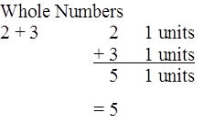
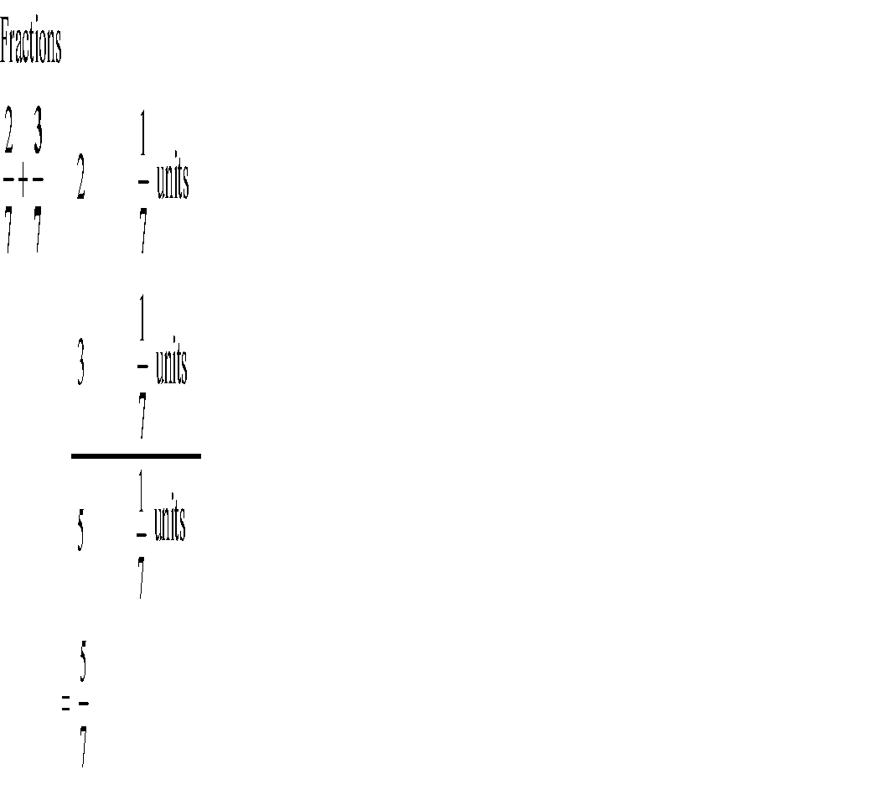
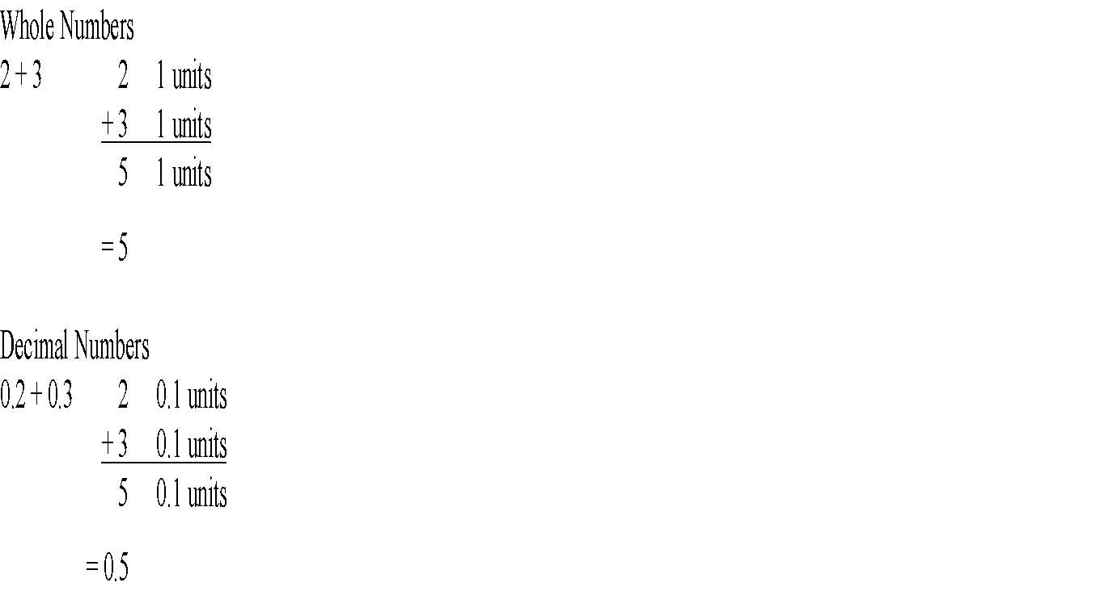
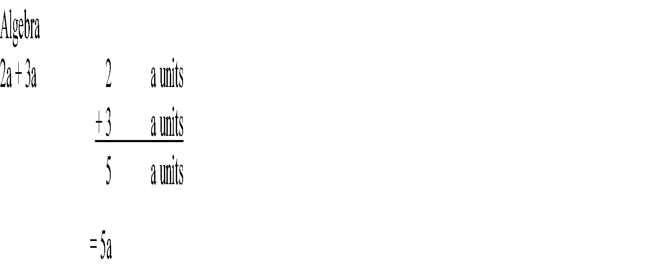
Unit Thinking is Powerful
It allows students to connect their understanding of operations across number systems.
Foods
2 cups + 3 cups 2 cup units
+ 3 cup units
5 cup units
= 5 cups
Technology
2 inches + 3 inches 2 inch units
+ 3 inch units
5 inch units
= 5 inches
Notes:
This slide is very powerful. It shows how unit thinking can be extended to other number systems and algebraic thinking. In the initial stages of the research, a Think Tank was formed on fractions learning. The international participants shared many different cultural practices around instructional practices, including the emphasis on unit within different number systems. This extends to operations, including addition, which is implicit in counting. Students can use their understanding of unit and the foundational components of operations (e.g., need same unit for addition/subtraction) to learn operations across number systems.
Let’s start with whole numbers. Although we don’t often explicitly say it, when we add 2 and 3 we are working with a unit of 1. When we extend into fractions, if students understand that ‘two sevenths’ is ‘two one-seventh units’ and that ‘three sevenths’ is ‘three one-seventh units’, then they can separate the count (numerator) from the unit. They can then add two and three to obtain five and then apply the unit to obtain five sevenths.
Similarly with decimal numbers, students can recognize that two-tenths and three-tenths can be separated so they can add the two and three and then apply the unit of tenths to obtain five tenths.
Secondary teachers can build on this within the study of algebra. Students can similarly consider 2a as 2 ‘a’ units and 3a as 3 ‘a’ units. They can add the 2 and 3 to obtain 5 and then apply the unit of ‘a’ to obtain 5a. Students would better understand the concept of collecting like terms.
Within our daily life, we do this type of separation of count and unit. Here are two examples (blue parts)– one from secondary foods courses and the other from secondary technology courses.
<<Participants may want to look at this slide for a minute or two.>>

Slide 18
Important things to remember
If you want to talk about fractions it is essential to know what the whole is. Unit fractions always reference their relationship to the whole.
Mixed, proper and improper fractions should all be presented simultaneously
Notes:
<<Read the first bullet>> We, as teachers, understand this but don’t often spend time making it very explicit to students. The Unit fractions counting game is one activity that supports student learning in this regard.
<<Read the second bullet>> The research is very clear about this. When we present mixed fractions first, students have a sense of the whole and see the fractional portion as a single quantity (not two distinct digits). For example, if they are presented with 1 ½, they will place it correctly between 1 and 2. This also allows students to connect fractions to their whole number understanding. Once students have the concept of unit, an improper fraction has meaning without them having to convert it to a mixed fraction.

Slide 19
Unit Fractions are Foundational
When fluency with equivalent fractions is developed, students are better able to consider addition of unlike fractional units by first relating each quantity to a common unit (common denominator). This is more powerful than a procedural approach to finding a common denominator (usually by multiplying the numerator and denominator by the same factor). This procedural approach may do little to support understanding of equivalence (since multiplying usually means ‘make bigger’).
Notes:
Take a few minutes to read this slide. <<Give people a couple of minutes to read it.>> When students understand unit fractions and that any unit fraction can be further partitioned into smaller unit fractions they can have increased fluency with equivalent fractions.
<< Research reference: Charalambous et al., 2010, 142; see also Carpenter, Fennema, & Romberg, 1993; Mack, 2001>>

Slide 20
Unit Fractions are Foundational (Continued)
When students transition to addition and subtraction of fractions, they must first understand that adding and subtracting always involves combining like units.
This understanding also aids in distinguishing the fractional unit, such as thirds, and the whole unit, such as cups, within a contextual problem.
Notes:
<<read first bullet>> Unit thinking can lead students to an understanding that fractions with unlike denominators cannot be added without changing them to like units.
<<read second bullet>>
<<Research references: First bullet: (Empson & Levi, 2011)>>

Slide 21
Count by Unit Fractions
When we count by unit fractions (like in the intro) we are using a whole of 1
We can count by unit fractions for other wholes as well.
π
y²
x
Notes:
As we look at content in intermediate and senior grades, unit fractions can be used with algebraic wholes such as x . <click> <<This animation is timed so it will add in pieces and change the count.>> We can do the same thing with other algebraic wholes, such as y squared. <click> This idea could also be extended into radian measure with a whole of π. This strategy extends into subsequent mathematics, providing students with entry points into new learning.

Slide 22
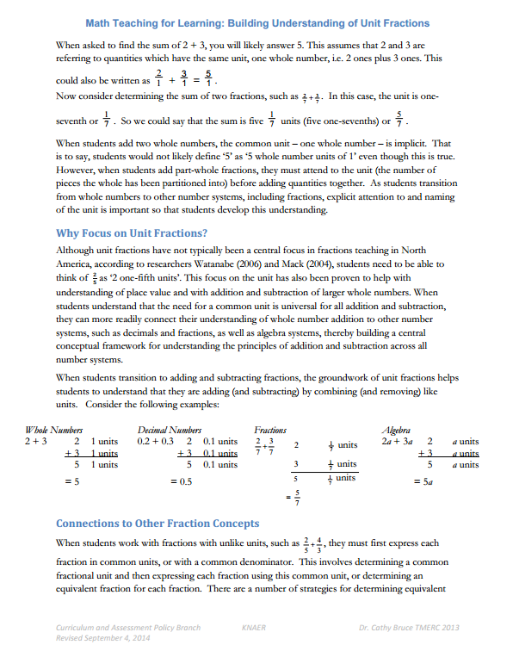
Math Teaching for Learning: Building Understanding of Unit Fractions
Notes:
<<Distribute the handout, one per participant>>
This is the one-pager that provides the foundation for the second part of our learning together.

Slide 23
Implications for Teaching
Engage students in composing and decomposing fractions using unit fractions (with models and symbolically)
Observe student understanding of equivalence and operations with fractions which emerge
Have students name the units, including counting by unit fractions (1 one-fifth, 2 one-fifths, 3 one-fifths, …)
Notes:
This research can impact classroom instruction in precise ways. This means more effective instruction rather than more time for instruction. Three strategies are:
Engage students in composing and decomposing fractions using unit fractions.
Observe student understanding of equivalence and operations with fractions which emerge. Far from being based in the formal algorithms, equivalence is understood when students identify that two fourths is equal to one half. Similarly, students recognize that if three fifths are shaded, then two fifths are not, demonstrating a grasp of the addition to one.
Have students name the units by counting unit fractions. This helps them distinguish the count (numerator) from the fractional unit (the denominator). Of course, we will want students to understand that we can say either ‘3 one-fifths’ or ‘three fifths’ and that it is the same quantity. Flexibility in understanding this allows students to be strategic – such as combining the counts and then considering the fractional unit when adding.

Slide 24
Fraction Language
Definitions and Meanings
Notes:
Now we are going to take a bit of time to examine the role of precise mathematical language for students. By using correct mathematical language consistently across grades and concepts, teachers provide students with terminology which they can use when engaged in mathematics. We are going to focus this discussion on partitioning, iterating and disembedding. These terms describe actions which are essential in developing fractions actions.

Slide 25
Composing Fractions on the Number Line using Unit Fractions
a) Choose one fraction:
b) Represent your fraction on a number line that goes
from:
0 to 1
0 to 2
to 1
Notes:
Choose one fraction <<read them – four-fifths, two-thirds, or three-fourths>> Ensure that all the fractions are selected at your table. Draw the three number lines and place your fraction on each one.
<<Allow a bit of time to complete this task>>
Compare your work with others at your table.
<<After table groups have had time to discuss>>
Which fraction was easiest to place? Why?
Which number line was easiest to place the fraction on? Why?
What strategies were used to place the fraction on the number lines? <<Participants may discuss how they partitioned the whole into appropriate unit fractions, such as fifths and then selected four one-fifths to represent four fifths. They are composing a fraction (four fifths) using a unit fraction (one one-fifth). The action of representing a fraction by creating a model and partitioning engages students in composing fractions. This is an important action in developing fraction number sense and understanding what a fraction is.>>
Notice that the relative placing of the fraction does not change from one number line to the next (i.e., each fraction is between ½ and 1). <<Highlight that ½ is a number, not ½ of the distance. Students will often place ½ at 1 on a number line that goes from 0 to 2. This demonstrates confusion between fraction as a number and fraction as operator (1/2 of the distance).>>
By seeing that a number line can be ‘zoomed in’ or ‘zoomed out’, students can start to understand that we can continually zoom in and create subsequent partitions within partitions. As we zoom in or out, the order of the fractions doesn’t change and the size of the units is always relative to the whole.
<<In their strategies, there may be examples of part-part thinking and this connects back to the multiple uses of fractions that we discussed earlier in the session. >>

Slide 26
Partitioning
Partitioning Shapes
Choose a shape and draw it
b) Partition your shape into a lot of equal regions
c) Use fractions to name the size of your regions
Notes:
Now I would like you to complete this task by choosing a shape, drawing it and partitioning it into a lot of equal regions. Once that is complete, name the size of your regions using fractions.
<<This activity will reinforce the idea of counting using unit fractions.>>
What were you thinking when you chose your shape?
What decisions did you make when you partitioned your shape?
How did you decide on the names of the fractional pieces?
What fractional understanding do your reflections reveal?
Notice that by using the language of ‘partition’ with students, they can concisely describe their actions. A student could say that they ‘equi-partitioned the shape’ or ‘created equal partitions’.

Slide 27
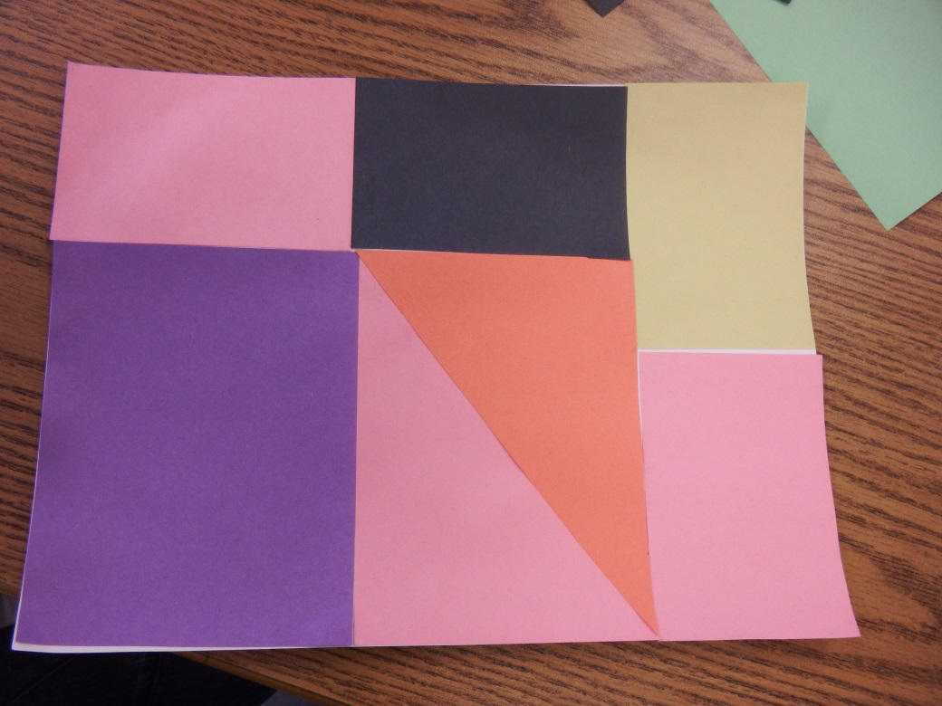
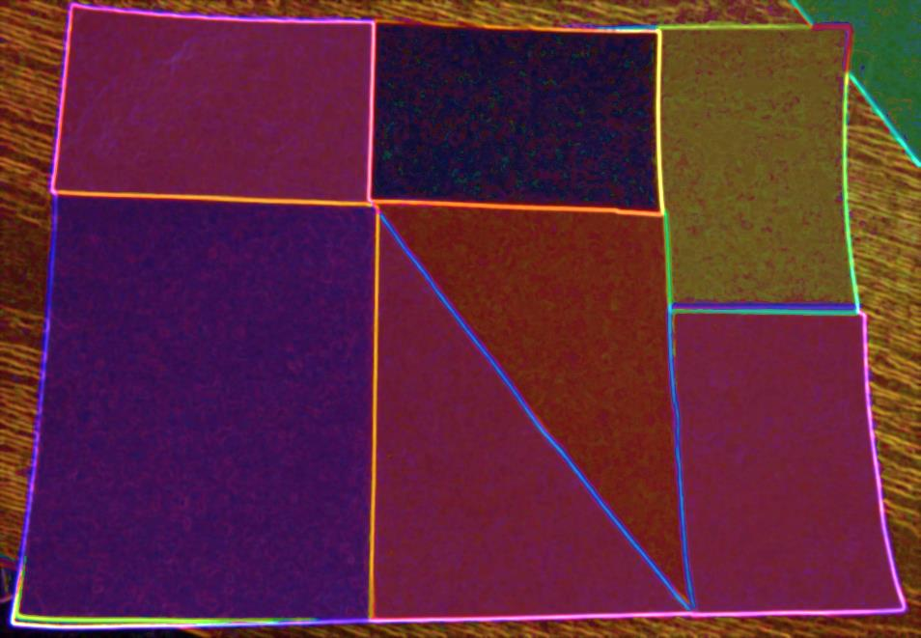
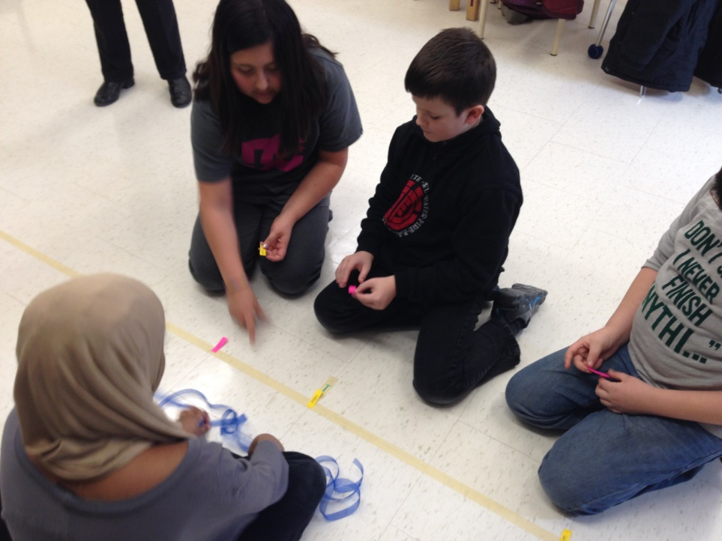
Partitioning Sample
Partitioning involves “creating smaller, equal-sized amounts from a larger amount”
Notes:
The formal definition of partitioning is ‘creating smaller, equal-sized amounts from a larger amount.’ In the first photograph, the area model is partitioned. In the second photograph, points are marked on a strip of tape, which is a linear representation.

Slide 28
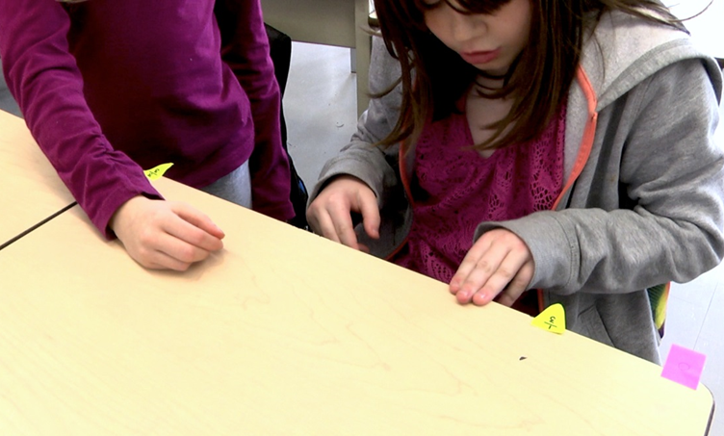
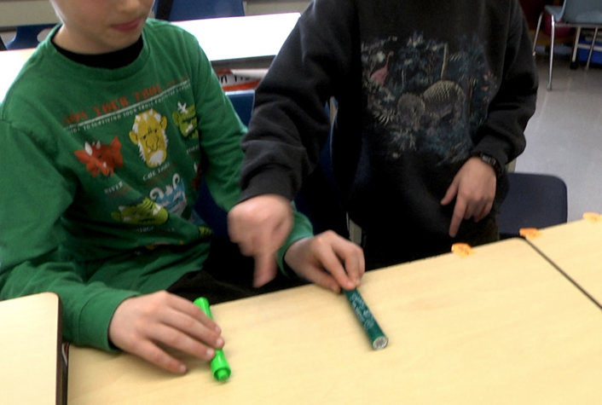
Iterating
Iterating involves “making copies of a smaller amount and combining them to create a larger amount”.
(Siebert & Gaskin, 2006, 395).
Notes:
Iterating involves ‘making copies of a smaller amount and combining them to create a larger amount’. When iterating, a student uses a unit fraction repeatedly to build the whole. Students may use a variety of strategies to iterate – repeating a non-standard unit of measure such as the left picture shows or a gesture with hands or objects as the right photo shows. Additionally, students may use standard units of measure, paper folding or manipulatives while iterating. Students can connect the action of repeating a partition to the word ‘iterate’ or repeat.

Slide 29
Partitioning and Iterating
Partitioning
Iterating
Notes:
Partitioning an area model to represent one-fifth involves dividing the whole into 5 equal regions (each region is equal in area), and showing one region.
Iterating an area model involves copying a unit of 1/5 (one-fifth) five times.
Students, through the process of partitioning, create unit fractions. They may count, using iteration, to create the whole.
To reinforce the importance of the unit fraction, students can count: “one one-fifth, two one-fifths, three one-fifths” etc. (Petit, et. Al. 2010)

Slide 30
Disembedding
Embedding involves seeing the part within the whole.
Disembedding involves considering the parts as separate from “the whole while keeping the whole mentally intact” (Hackenburg and Lee)
Notes:
Disembedding is very closely related to partitioning and iterating. These students are most likely mentally holding the whole simultaneously with the smaller partitions which they are iterating. Additionally, students may use standard units of measure, paper folding or manipulatives while iterating.
In the photo on the left, we can see that a student is using three finger widths as a measure of one partition to compare estimation of the partition to the whole. On the right, these two students are using markers to hold the size of the partition while at the same time realizing that the size of this piece is in relation to the whole.

Slide 31
Disembedding Samples
If this piece represented one-fifth of the whole, what would the whole look like?
If this piece represented one-half of the whole, what would the whole look like?
If this piece represented one-tenth of the whole, what would the whole look like?
Notes:
Now you can experience disembedding. If this piece represented one-fifth of the whole, what would the whole piece look like? <<Have them picture each one in their head before showing the picture.>>
<<repeat for the next two prompts>>
In this way, you can see how seeing one piece and knowing the name (unit) of that piece simultaneously provides you with a sense of the size of the whole. You are holding the piece ‘disembedded’ from the whole but still holding information about the size of the whole.

Slide 32
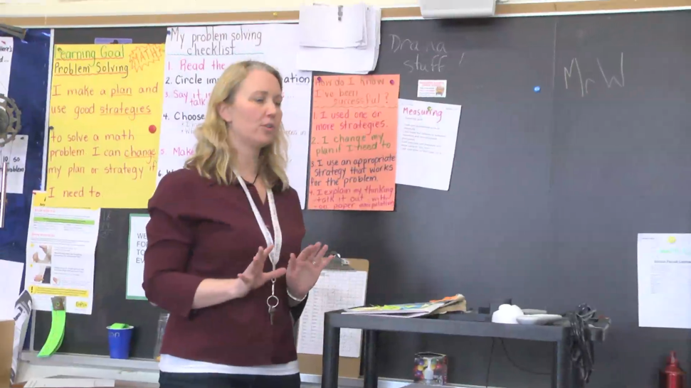
‘Desktop’ Task
What did you notice the students doing?
partitioning?
iterating?
disembedding?
Notes:
<<Need Quicktime Movie.>> Show the video of a teacher presenting task and a pair of boys who describe what they did. The edge of desk top is partitioned as the boys placed the fractions they were given which lie between 0 and 1. (**Note that the teacher may ask about 1/2 but later the students are using 1/3).
Participants may note that:
when the boys switched to the longer edge of the desk, they adjusted their placement of the stickies to accommodate for this change
the boys used their hands to help them explain. Ensure this idea is brought out if none of the participants mention it
the teacher was also gesturing as she introduced the task >>

Slide 33
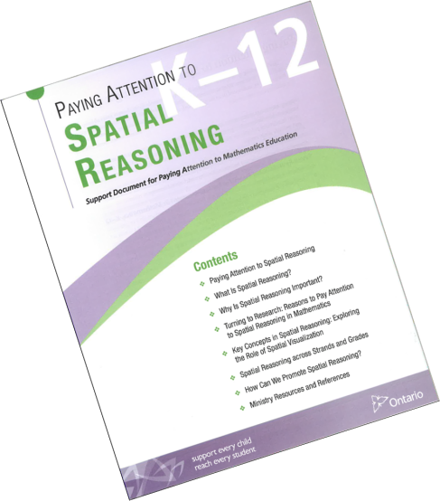
Paying Attention to Spatial Reasoning
Gestures
…gesturing—that is communicating ideas through the use of the hands—is an often under-used yet often-overlooked form of communication. Gesture is an especially
powerful means of expressing spatial information and provides information to the listener that is not always expressed in words.
Paying Attention to Spatial Reasoning, p. 22
Notes:
It’s important to value the boys’ use of gestures to explain their thinking. The Ministry document, Paying Attention to Spatial Reasoning, which was released in Spring 2014, discusses some recent research around the role of hand gestures in mathematics learning. Several studies in this field suggest that using gestures helps build student understanding. Furthermore, both teacher and student use of gestures has been seen to correlate strongly to student achievement. Teachers should consider observations of student use of gestures as another means of assessing understanding. Students engaged in this activity could possibly be videotaped.

Slide 34
Sequencing Partitioning and Iterating
Petit et al. (2010) suggest
1. partitioning by repeated halving
2. partitioning of other even numbers, such as tenths
3. partitioning odd numbers
4. partitions, such as twelfths, which can be constructed using a rectangle partitioned into 3 rows and 4 columns
Iterating could be reinforced if students were asked to reconstruct the whole from a part.
Notes:
Petit et al. (2010) suggest a specific sequence for partitioning and iterating:
1. Begin with partitioning that involves repeated halving (one half, then halving each half, and so on); <<In the fractions research, students demonstrated an overreliance on repeated halving strategies and limited ability to do the following partitions>>
2. Next, create partitions of other even numbers, such as tenths (which allow for partitioning of one-half and require further partitioning of each half into fifths);
3. Students should next create odd number partitions, such as ninths and sevenths (which require partitioning other than one-half);
4. Students should then work with composite number partitions, such as twelfths, which can be constructed using a rectangle partitioned into 3 rows and 4 columns . This engages students in multiplicative reasoning to construct the wholes as ‘3 groups of 4’.
Students can use multiplicative reasoning to also reconstruct the whole from a part (iterating).
The use of linear (and some area) visual representations, such as number lines and bars, strips or ribbons, enable students to think about partitioning and iterating as relative length or distance (or area) relationships, which is a particularly powerful way to make sense of fractional parts.
The Pretty Powerful Paper Folding activity, located in Comparison E on the Fractions Learning Pathways, engages students in partitioning using these strategies.

Slide 35
Connecting Unit Fractions and Fractions Language Through Tasks

Slide 36
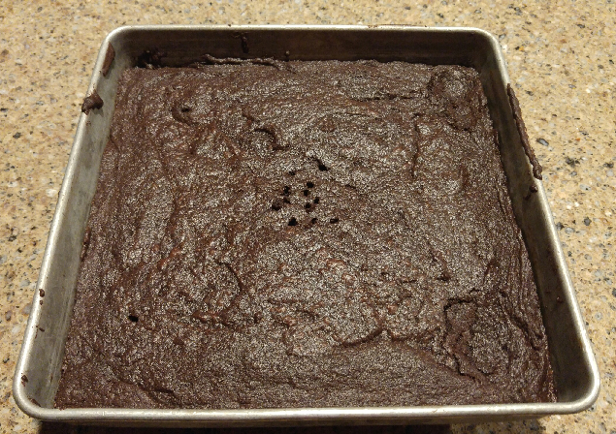
Brownie Task – Act 1T
Consider this tray of brownies.
How would you share it fairly between yourself and three friends?
Notes:
<<See The Brownie Task at Fractions Learning Pathways (Unit B) http://www.edugains.ca/newsite/DigitalPapers/FractionsLearningPathway/UnitFractions-B-brownieSharing.html for the instructions and materials related to this task. Provide each group with a number of same-sized papers for folding (recycled paper is fine). Note that the task can allow for use of scissors or not. The subsequent video shows use of scissors.>>

Slide 37
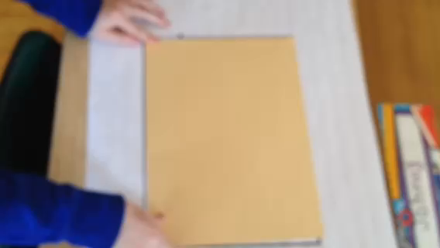
Paper Folding Video
Paper folding as a way of making equal shares
Notes:
<<Quicktime Movie>> or <<https://youtu.be/CSHr3ASBRWs>>
Now we will view a video of two students’ thinking.

Slide 38
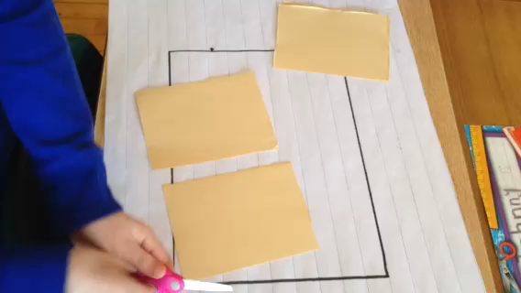
Strategies
Cutting and checking for equality.
Then comparing the pieces to the whole.
The pan is the whole.
The brownie pieces are not the whole.
Notes:
<<Quicktime Movie>> https://youtu.be/G3EOQBKi_Ik
Discuss the strategies that you used. <<allow participants to share>>

Slide 39
Brownie Task 2
Brownie Task – Act 2T
Consider this tray of brownies.
How would you share it fairly between yourself and three friends?
Four more people arrive – how would you share it fairly now?
Notes:
<<Have participants work through the second prompt. Encourage them to get a fresh sheet of paper if they wish.>>

Slide 40
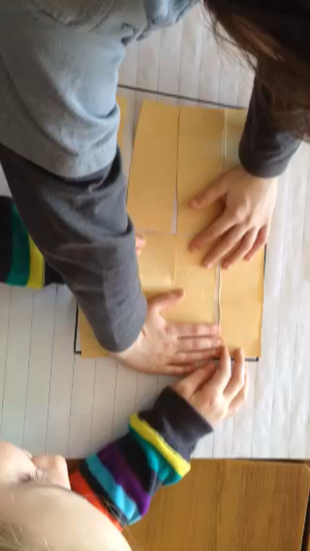
Folding Paper
Folding in half.
Folding in fourths.
Folding in eighths.
A doubling effect!
Notes:
<<Quicktime Movie>>or <<https://youtu.be/CSHr3ASBRWs>>
Now let’s watch another video of how two students thought of this task.

Slide 41
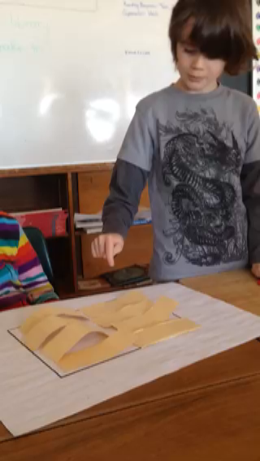
Counting Brownie Pieces
1 one-eighth
2 one-eighths
3 one-eighths
Four-eighths
Five-eighths
Six-eighths
Seven-eighths
Eight-eighths
Notes:
This video <<https://youtu.be/Ki2jEDAkdcg>> shows that students struggle with unit fractions, but counting by unit fractions supports students in determining if their answer is reasonable.

Slide 42
Brownie Task 3
Brownie Task – Act 3T
Consider this tray of brownies.
How would you share it fairly between yourself and three friends?
Four more people arrive – how would you share it fairly now?
Two more people arrive – how would you share it fairly now?
Notes:
<<Have participants work through the third prompt. Encourage them to get a fresh sheet of paper if they wish.>>

Slide 43
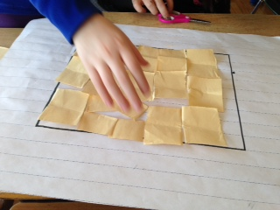
Folding Solution
Working on a solution for 10 people!
THE PAN is a key reference for considering the whole in relation to the parts.
Notes:
There are two ways to have students complete the task. If they can only fold (i.e., not cut the paper) then they will always have the whole (in the piece of paper). If you allow students to cut the pieces apart, then you have to provide a whole referent so that they will notice if they omit pieces as they are cutting.
<<Note that these students will be giving each person one and a half of their pieces>>

Slide 44
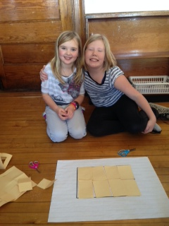
Moral of the Story
The moral of the story is sharing brownies brings people together.
Notes:
Students love this task. It has been used with students from grade 2 through to secondary to build understanding of equi-partitioning and unit counting. By changing the questions asked, the mathematics can reflect the grade expectations. For example, connections can be made to area measurements (What is the area of each region? Of the whole pan? How would the area of the pan compare to the volume of the brownies?); to proportional reasoning (How do the pieces compare to each other in each of the three scenarios?); to percentages (What percentage of the pan does one person get in each scenario?). Teachers reported that students appeared to become more flexible in their thinking after completing this task and the Pretty Powerful Paper Folding task, both of which require students to abandon a strategy when it is not working and step back to rethink the task.

Slide 45
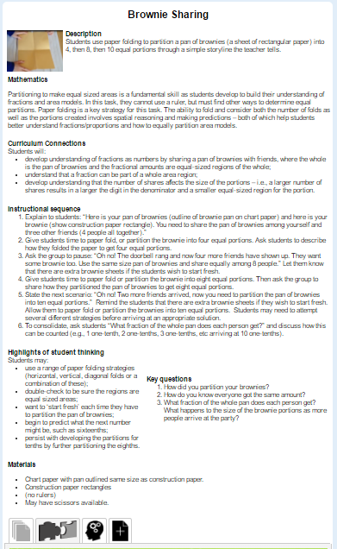
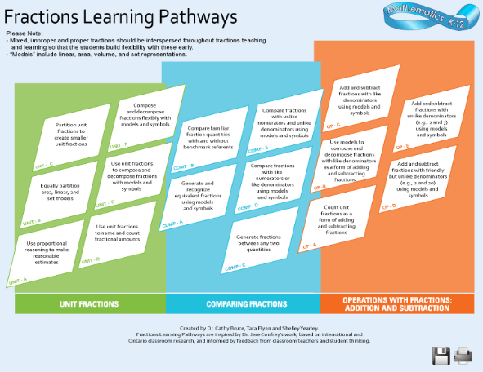
Brownie Sharing Task
Fractions Learning Pathways: Unit B
Notes:
The Brownie Sharing task, along with supporting resources such as student thinking, is located at Unit B in the Fractions Learning Pathways.

Slide 46
Developing Proficiency
“When students can construct and deconstruct fractions in this manner they understand that a fraction is a number and develop a ‘fractional number sense’. This supports them in subsequent fraction learning, including operations where they will be better able to estimate the answer before completing the calculations.”
Math Teaching for Learning: Developing Proficiency with Partitioning, Iterating, and Disembedding , 2013
Notes:
<<Read quote.>> Often fractions are introduced with pre-partitioned figures and students are asked to write a fraction representing the shaded area. These types of tasks reinforce a whole number count (students may learn to ‘count the shaded regions and write that number on top; count the total number of regions and write that number on the bottom’) and the mistaken understanding that a fraction is two numbers (i.e., not see a fraction as a number expressing a relationship between the digit in the numerator and the digit in the denominator). Tasks such as the Brownie Task are examples of more precise instruction. Students need to partition, iterate and disembed, actions which support them in developing deep understanding of fractions. The Brownie Task doesn’t take more time than the pre-partitioned figure tasks but does result in enhanced understanding.

Slide 47


Spatial reasoning connection: Composing, decomposing, and transforming 2D figures
Identifying shapes within shapes
Composing one shape from two smaller shapes
Predicting the results of taking a shape apart and putting it together
Predicting what a shape will look like after it is flipped or rotated
Notes:
There are connections to Spatial Reasoning throughout the fractions learning. Composing, decomposing, and transforming two-dimensional (2D) figures may involve <<read the bullets>>
It is recommended by the National Council of Teachers of Mathematics that all children from pre-Kindergarten to Grade 2 have opportunities to “investigate and predict the results of putting together and taking apart two-dimensional shapes” <<National Council of Teachers of Mathematics [NCTM], 2000, p. 96)>>.
Many studies have shown that activities that involve composition and decomposition of 2D shapes, including working on puzzles, paper cutting and folding, and playing games such as Tetris, build spatial thinking skills, including mental rotation and visualization, both of which are critical to mathematical ability <<(Cakmak, Isiksal, & Koc, 2014; Casey et al., 2008; Levine et al., 2012; Okagaki & Frensch, 1994; Terlecki, Newcombe, & Little, 2008; Verdine et al., 2008). >>
These early experiences lay the foundation for future success in geometry. They are as important for the development of geometric thinking as composing and decomposing numbers are for the development of number sense.
See Paying Attention to Spatial Reasoning for more information.
<<images are from:
https://commons.wikimedia.org/wiki/Category:Tangrams_of_convex_geometrical_shapes
https://commons.wikimedia.org/wiki/File:Tangram_178_Nevit.svg>>

Slide 48

Connecting Back to Unit Fractions and Comparing Fractions
Many intermediate teachers stated that revisiting the Unit Fractions and Comparing Fractions strands to respond to identified gaps in student knowledge significantly reduced the time required for (and the struggles with) addition and subtraction of fractions.
Notes:
This slide connects unit fractions to both comparing fractions and operations with fractions. It reinforces the power and importance of unit fraction understanding in order to develop fraction number sense. The activities in the Fractions Learning Pathways, such as the Unit Fraction Counting Game help to build that understanding, which provides a solid foundation for learning about operations with fractions. Intermediate teachers have found that they can build students’ foundational understanding in a targeted manner in order to ready students for success in operations with fractions. <click>
For example, focusing on unit fraction counting (Unit D) helps students understand that counting unit fractions is also a form of addition (or subtraction if counting backwards) (Op A). <click>
Providing students with opportunities to compose and decompose fractions (Unit F) enables them to explore addition and subtraction through composing and decomposing fractions (OP B). <click>
Partitioning unit fractions into smaller unit fractions (Unit C) provides students with strategies to create equal denominators to add or subtract fractions (Op D). <click>
Similarly, generating and recognizing equivalent fractions (Comp A) supports students in Op D. <click>
Finally, focusing on Comp A also supports students in Op E.
Intermediate teachers who focused on tasks from Unit C, D and F as well as Comp A found that students more easily grasped the concepts of addition and subtraction of fractions.

Slide 49
Unit Fractions across the K-12 Curriculum
Identify an expectation from the grade you teach from the page provided.
Read the section above the expectation.
Identify a question or task that you have used in your classroom which addresses that expectation.
Discuss with your table mates.
Notes:
<<Distribute BLM 3 Unit Fractions Across the K to 12 Curriculum, one per person>>
Now we will connect the role of unit fractions in your specific grade curriculum. <<You may choose to group the participants by grade or have a cross-section of grades for the discussion. This is a good summary of the concepts that were presented today. Highlight the connections of the ideas across the different grades. Teachers of Grade 7 may wish to examine their curriculum or connect to either the Grade 6 expectation (since students must also represent,compare and order numbers in Grade 7) or the Grade 8 expectation (since students must also understand estimation with fraction addition and subtraction in Grade 7). Teachers of Grade 9 may likewise wish to examine their curriculum or connect to the Grade 8 expectation (since students must complete calculations with fractions in Grade 9).>>

Slide 50
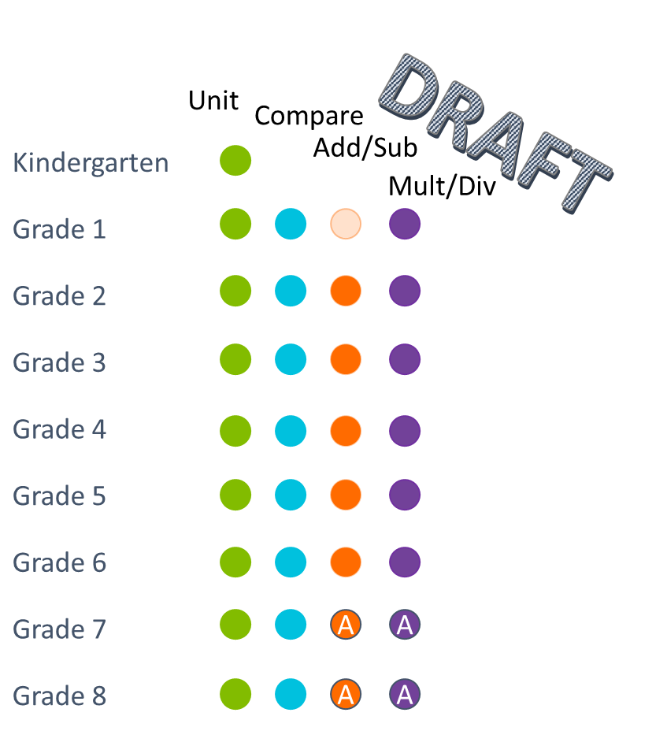
The FLP Across the Grades
Notes:
<<Coloured dots indicate that knowledge and skills related to the corresponding cluster (e.g., green – unit) are included in that grades learning. Light shading indicates the learning is implicit. An A shows where algorithms or procedures may be introduced.>>
Students explore equivalent fractions using concrete materials in grade 4; they focus on the multiplicative relationships in grade 5; they explore addition and subtraction in grade 2 when they compose fractions; they explore multiplication for example: when you have 6 cookies and each person can have half of a cookie – how many people can you feed? OR, you have 6 people so how many cookies do you need?

Slide 51
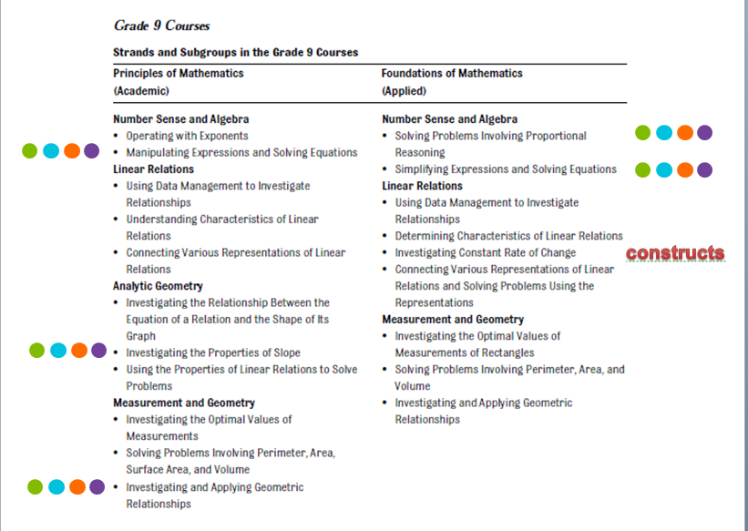
Fractions Learning Pathways
Multiply/Divide
Add/Subtract
Compare
Unit
Notes:
<<The coloured dots refer back to the Fractions Learning Pathways. The green dots represent Unit Fractions, turquoise is Comparing Fractions, orange is Operations with Fractions; Adding and Subtracting, and purple is Operations with Fractions: Multiplying and Dividing. The multiplying and dividing section of the Pathways is still under development.
This slide is powerful for secondary teachers. It becomes apparent that there are many topics in the secondary curriculum that rely on fractional understanding>>

Slide 52
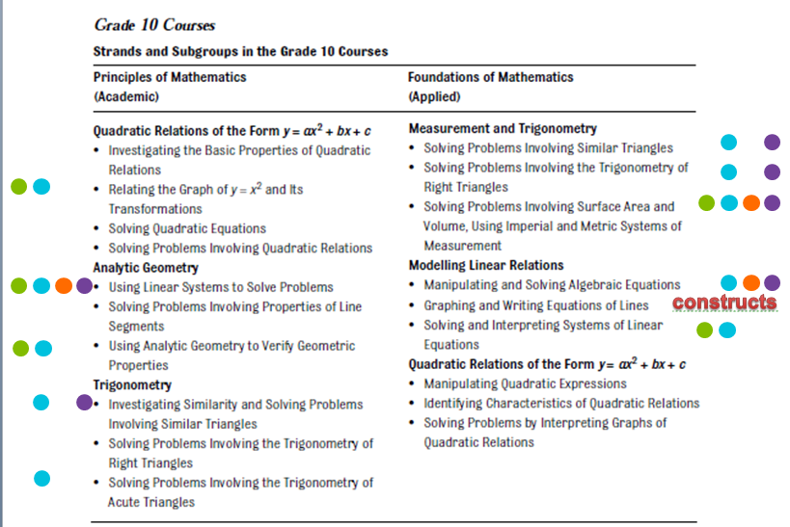
FLP - Grade 10 Courses
Multiply/Divide
Add/Subtract
Compare
Unit
Notes:
<<The coloured dots refer back to the Fractions Learning Pathways. The green dots represent Unit Fractions, turquoise is Comparing Fractions, orange is Operations with Fractions; Adding and Subtracting, and purple is Operations with Fractions: Multiplying and Dividing. The multiplying and dividing section of the Pathways is still under development.
This slide is powerful for secondary teachers. It becomes apparent that there are many topics in the secondary curriculum that rely on fractional understanding>>

Slide 53
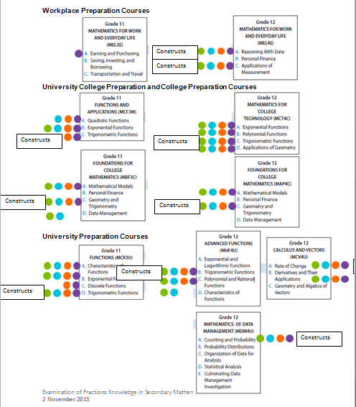
Grade 11 and 12 Courses
Multiply/Divide
Add/Subtract
Compare
Unit
Notes:
<<The coloured dots refer back to the Fractions Learning Pathways. The green dots represent Unit Fractions, turquoise is Comparing Fractions, orange is Operations with Fractions; Adding and Subtracting, and purple is Operations with Fractions: Multiplying and Dividing. The multiplying and dividing section of the Pathways is still under development.
This slide is powerful for secondary teachers. It becomes apparent that there are many topics in the secondary curriculum that rely on fractional understanding>>

Slide 54
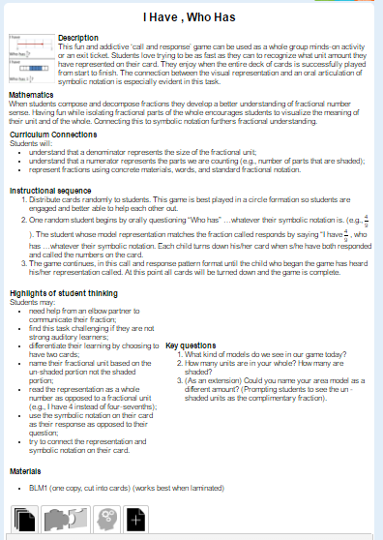
I Have … Who Has …
Fractions Learning Pathways: Unit F
Notes:
<<Using http://www.edugains.ca/newsite/DigitalPapers/FractionsLearningPathway/UnitFractions-F.html Provide each table with a set I Have, Who Has? cards (one set for 3 - 4 people) and have them play the game.>>

Slide 55
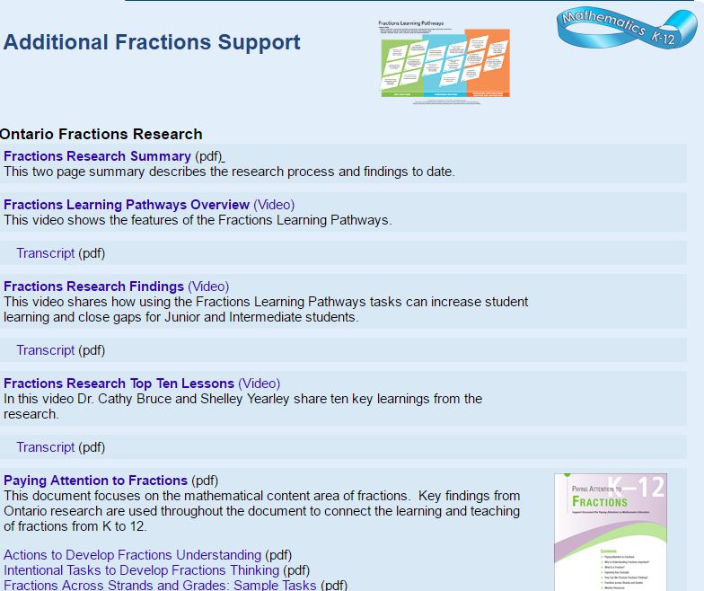
fractionsteaching.ca
Notes:
All the fractions resources are located at fractionsteaching.ca
This includes the Paying Attention to Fractions document, support documents (4) and the Adobe Presenter which allows you to hear more about the mathematics contained within the document. As well, research summary ‘one pagers’ and complete literature reviews are located here so that you can read the research yourself. The Fractions Learning Pathway is at the top and various videos and webinars allow you to personalize your learning. There is also a digital paper on the Professional Learning journey early in the research on represent, compare, and order.

